Slide 1

f
DEPARTMENT OF COMPUTER SCIENCE AND ENGINEERING
JOB PORTAL
Batch Number:21PA14
SEC: CSE-A
IV-I
UNDER THE GUIDENCE OF, Presented By,
G.ARUN A. Tharun(21P61A0510)
Assistant professor A. Sanjay(21P61A0511)
CSE

Slide 2
Contents
1.Abstract with keywords
2.Introduction
3.Problem Statement
4.Objective
5.Proposed Methodology
6.Software and Hardware Requirements.
7.Conclusion
8.References

Slide 3
Abstract
This project aims to develop a comprehensive online job portal designed to streamline the recruitment process for both job seekers and employers. The platform will provide a user-friendly interface for job seekers to create and manage their profiles, search for relevant job openings, and apply directly to potential employers. For employers, the portal will offer tools to post job vacancies, screen resumes, schedule interviews, and track the entire hiring process efficiently.
Key Words: Opencv,Java script, Html, Sql, Local binary patters

Slide 4
Introduction
The job portal project aims to establish an online platform designed to streamline the recruitment process by connecting job seekers with potential employers.
In the contemporary job market, such platforms serve as crucial tools, facilitating efficient job discovery and application management.
The job portal system is a platform between job seeker(student) and job provider(company).
The Student or Job seeker can easily find and apply for job by login into system. The Employer or company can easily get expert employee from our job portal site by posting a job.
The job portal website is a common place between job seeker and company. When job seeker can login in his account then he can get notification of company lists which match with his profile or education detail. so job seeker can easily apply to this job and he can also send message to company for other inquiry.
When company login in account, company or employer can get alert of job seeker lists which match with all criteria for posted job.

Slide 5
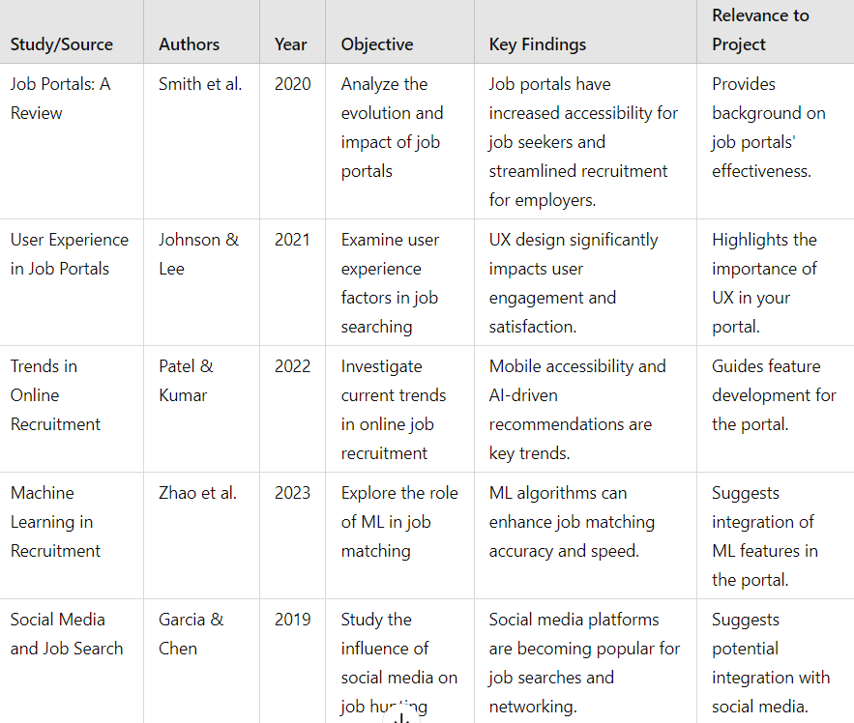
LITERATURE SURVEY

Slide 6
Problem Statement
Difficulty in Accessing Opportunities: Job seekers struggle to find relevant positions due to scattered job postings and a lack of advanced filtering options.
Limited Candidate Outreach: Employers face challenges in reaching a diverse and qualified talent pool effectively.
Inefficient Application Management: Managing and tracking applications becomes cumbersome without an organized system.
Skill-Job Mismatch: Both parties often face mismatches in skills and job requirements, leading to unsatisfactory outcomes.
Lack of Real-Time Updates: Job seekers and employers miss out on timely updates about applications, interviews, or new postings.

Slide 7
Objective
The objective of this project is to provide the information about new jobs.
A user can search jobs according to their location or their skills. It provide the resume tips and interview tips which is useful to provide the guideless to the user.
A company organization can post the new jobs which is store in the new job database and according to this new database a employer and jobseeker or employer can search this new jobs.
The job portal project aims to create an online platform where job seekers can find suitable job opportunities and employers can post job vacancies.
In today's digital age, such platforms serve as pivotal tools in the employment ecosystem, connecting talent with organizations efficiently and transparently.

Slide 8
EXSISTING SYSTEM
User Registration: Allows job seekers and employers to create accounts.
Profile Management: Users can update personal and professional information.
Job Posting: Employers can post job vacancies with detailed descriptions.
Job Search: Job seekers can search for jobs using filters like location, industry, and keywords.
Application Tracking: Users can track the status of their job applications.
Resume Upload: Job seekers can upload resumes for potential employers to view.
Notifications: Users receive alerts for new job postings and application status updates.
Admin Dashboard: Admin can manage users, job postings, and site content.
Search Optimization: Implemented SEO features for better visibility.
Analytics: Basic analytics for tracking job views and application rates.

Slide 9
PROPOSED SYSTEM
Enhanced User Interface: A modern, intuitive design for better user experience.
AI Job Recommendations: Personalized job suggestions based on user profiles and preferences.
Advanced Search Filters: More refined search options, including salary range, job type, and company ratings.
Integrated Chat System: Real-time communication between job seekers and employers.
Video Resumes: Option for job seekers to upload video introductions along with resumes.
Skill Assessment Tests: Employers can create tests to evaluate candidate skills before interviews.
Mobile App Development: A dedicated mobile application for easier access and notifications.
Employer Branding: Tools for companies to showcase their culture and values.
Feedback System: Allows users to leave reviews on job experiences and employers.
Data Analytics Dashboard: Detailed insights for employers on candidate engagement and application trends.

Slide 10
Proposed Methodology
1. Requirements Gathering and Analysis:
Identify the needs of both job seekers and employers.
Determine core functionalities and features.
Define system requirements, including technical specifications.
2. System Design:
Create a detailed system architecture, including database design.
Design user interfaces for job seekers and employers.
Develop data flow diagrams and use case diagrams.
3. Development:
Implement the front-end using HTML, CSS, and JavaScript frameworks (e.g., React, Angular).
Integrate a robust database system (e.g., MySQL, PostgreSQL).
Implement security measures to protect user data.
4. Testing and Quality Assurance:
Conduct unit testing, integration testing, and system testing.
Identify and fix bugs and errors.
5. Deployment:
Deploy the job portal to a web server.
Configure the server environment for optimal performance.

Slide 11
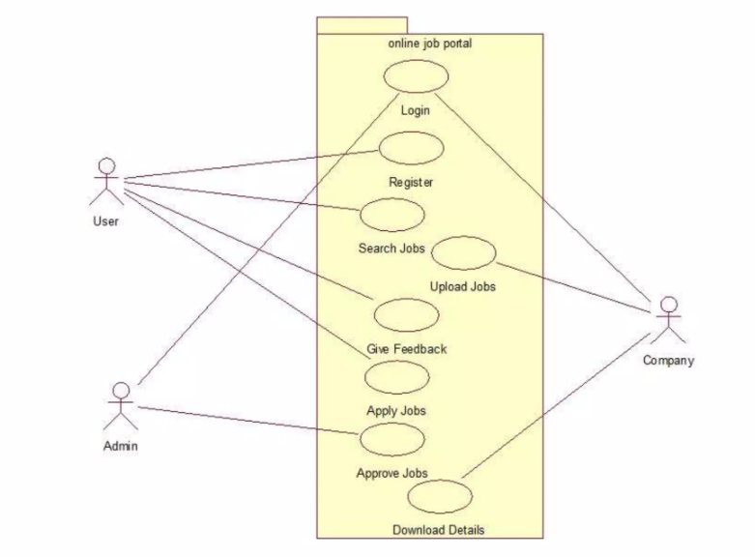
MODULES

Slide 12
IMPLEMENTATION
User Registration:Job Seekers: Create profiles with details like resume, skills, experience, and preferences.Employers: Createaccounts to post job openings, search resumes, and manage recruitment processes.
Job Posting and Search:Employers: Post job listings with descriptions, requirements, and deadlines.Job Seekers: Search for jobs based on keywords, location, industry, or specific criteria.
Resume Uploading and Matching:Job Seekers: Upload resumes in various formats (PDF, DOCX, etc.).Employers: Search resumes using keyword matching or advanced search filters.
Application and Tracking:Job Seekers: Apply for jobs directly through the portal.Employers: Review applications, shortlist candidates, and schedule interviews.
Communication and Collaboration:Messaging: Enable direct communication between job seekers and employers.Notifications: Send alerts for new job postings, application status updates, and interview invitations.
Security and Privacy:Data Encryption: Protect sensitive information like resumes and personal details.Access Controls: Implement strong authentication and authorization mechanisms.
Analytics and Insights:Track User Behavior: Monitor user activity to understand trends and preferences.
Generate Reports: Provide insights into job postings, applications, and hiring trends.
Technical Implementation:Frontend: HTML, CSS, and JavaScript for user interface and interaction.
Backend: Programming languages like Python, Ruby, or Java to handle server-side logic and database interactions.
Database: Store user data, job listings, and application information (e.g., MySQL, PostgreSQL).

Slide 13
Software Requirements
Operating System: Windows 11 Home Single Language
Coding Language: Java script
Data Base: CVS/text
Hardware Requirements:
RAM: 8.00 GB
Hard Disk: 476 GB
Processor:12th Gen Intel(R) Core(TM) i5-1240P 1.70 GHz

Slide 14
Conclusion
The job portal project successfully bridges the gap between job seekers and employers by offering a user-friendly and efficient platform for career opportunities and recruitment processes. The system provides essential functionalities such as job posting, resume management, application tracking, and advanced search capabilities. By integrating modern technologies like AI for recommendations and real-time updates, the portal enhances the user experience and streamlines hiring operations.
Moreover, its scalable architecture ensures that the platform can accommodate growing user bases, while robust security features protect sensitive data. This project not only demonstrates the potential of digital solutions in recruitment but also sets the foundation for future enhancements, such as AI-driven analytics, skill assessments, and global outreach. It is a valuable tool for modernizing and simplifying employment processes in today's competitive job market.

Slide 15
References
https://www.ijser.org/paper/Different-Watermarking-Techniques-its-Applications.html
www.w3school.com (it helps HTML, AJAX, JavaScript & etc)
www.asp.netpractise.com
Bsiri. S and Geierhos. M and Ringlstetter. C.(2008) “Structuring job search via local grammars,” Advances in Natural Language Processing and Applications, pp. 201.
Dorn. J and Naz. T.(2007) .“Integration of portals by Meta-search,” in Proc. 3rd International Conf. on Interoperability for Enterprise Software and Applications, Funchal, Portugal, pp. 401-412.
Galanki. E.(2002) “The decision to recruit online: a descriptive study,” Career Development International, vol. 7, pp. 243- 251.
Job recruitment and job seeking processes: how technology can help, Digital object identifier10.0019/MITP.2013.62,1520-9202/20 1520-9202/2013 IEEE

